Slide 1
Assembly Language

Slide 2
Why we study Assembly Language
To control on operating system and design softwares accordingly because if we have the knowledge of processor we can work accordingly
To enhance the perforce of system processing
To understand the processor
To arrange the processor requirements as per capacity
To understand the low level language
Hardware and software combination to work together
Because you don’t define particular memory address where to data store and where not so efficiently system does so all about due to AL
Direct access to register to execute the process rather to carry out things from hard to ram to cache to register

Slide 3
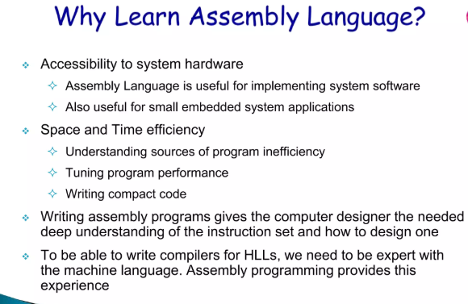

Slide 4
How different is Assembly Language then Other Programing Languages
250 Languages we use up to natural language processing
Low level language
Direct access to register and processor
Embedded Programing direct access to hardware
Not a web base or mobile base application
A right techniques to a right problem
Procedural non procedural
For web for desktop for Mobile app but we need to command the processor too for enhancement of the internal function of processor

Slide 5
What is actual Assembly Language
David John Wholer computer programming, assembly language,
often abbreviated asm,
low-level programming language
there is a very strong correspondence between the instructions in the language and the architecture's machine code instructions
can be used to directly tell the computer what to do
almost exactly like the machine code that a computer can understand, except that it uses words in place of numbers.

Slide 6
What is Assembler role in AL its types
An assembler is a program that converts assembly language into machine code. It takes the basic commands and operations from assembly code and converts them into binary code that can be recognized by a specific type of processor. Assemblers are similar to compilers in that they produce executable code.
Emulator 8086
Visual Studio With libraries of AL
MASM
DosBox .asm .obj; link; exe

Slide 7
Advantages and Disadvantages of using AL
Programs written in machine language are replaceable by mnemonics which are easier to remember
It allows complex jobs to run in a simpler way.
It is memory efficient, as it requires less memory.
It is faster in speed, as its execution time is less.
It is mainly hardware oriented.
It is used for critical jobs.
It is not required to keep track of memory locations.
No SDKs (System Development Kit).
more complex in nature.
Difficult to remember the syntax.
It is difficult to debug the program.
It has a lack of portability of program between different computer architectures.
It needs more size or memory of the computer to run the long programs written in Assembly Language

Slide 8
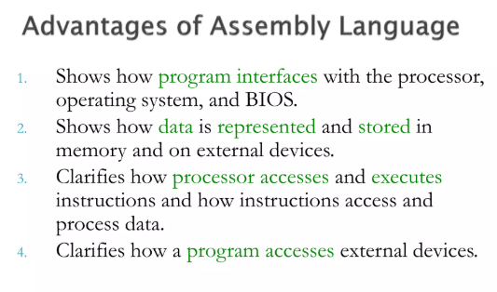
AL Pro’s & Con’s
High development and implementation cost
Requires large amounts of data to function effectively
Lacks human creativity, emotions, and intuition
Limited ability to handle unexpected or novel situations
Complex systems are difficult to understand and debug
Requires continuous maintenance and updates

Slide 9
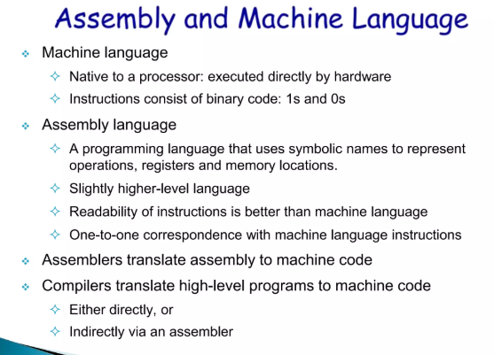

Slide 10
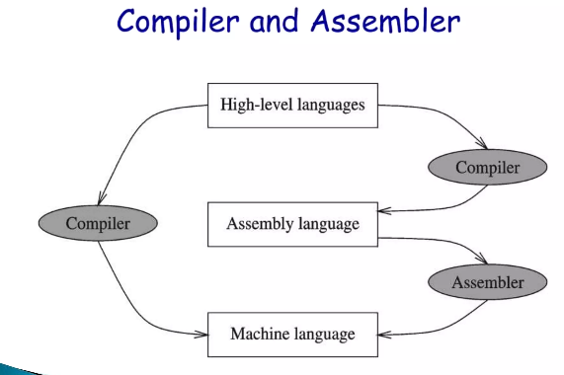

Slide 11
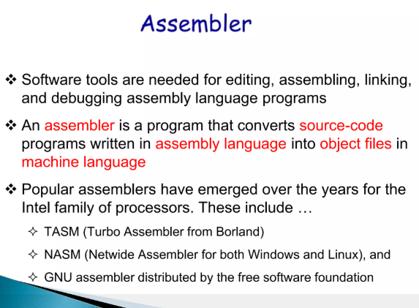

Slide 12
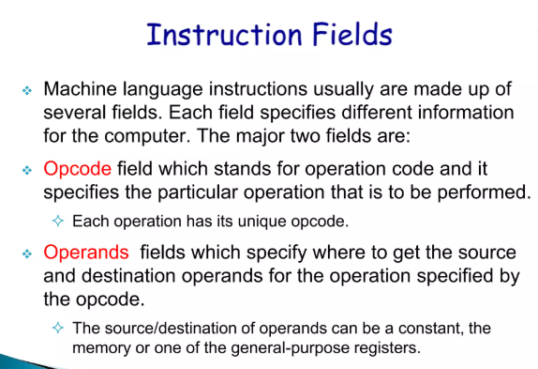
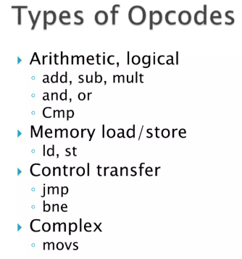
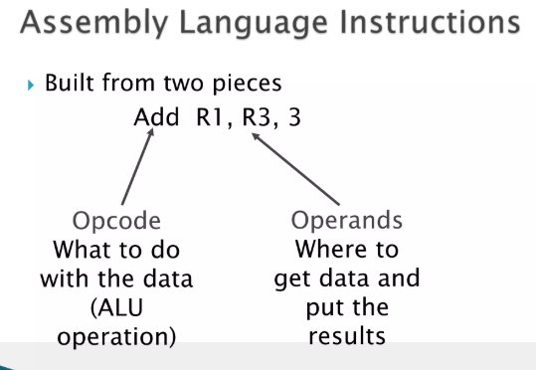

Slide 13
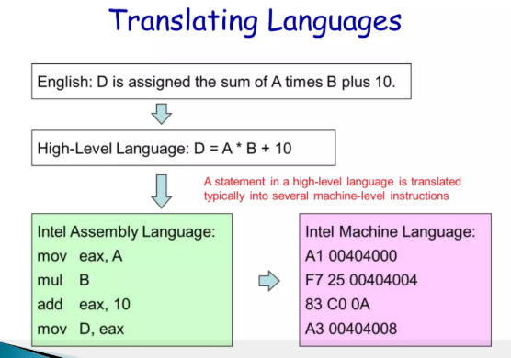

Slide 14
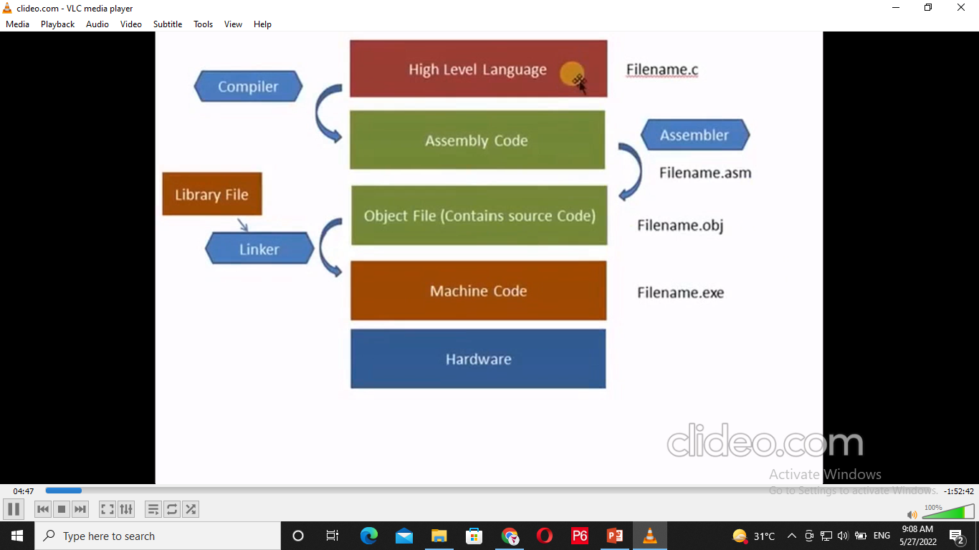

Slide 15
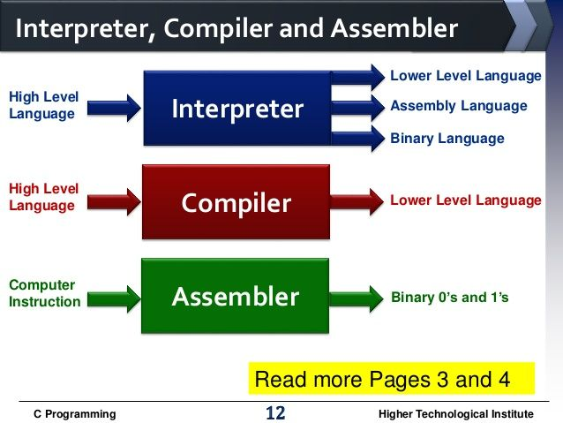
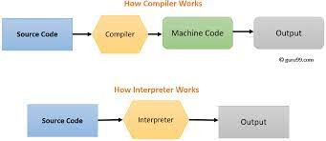

Slide 16
Key Terms
Compiler
Interpreter
Translator
Linker & Loader
Assembler Assembly to object /byte
Opcode, Operands, Statement, Mnemonics are keywords like MOV DL,5 ADD BX, DX
opcode is the portion of a machine language instruction that specifies the operation to be performed
Linking and Loading are the utility programs execution of a program. Linking intakes the object codes generated by the assembler and combines them to generate the executable module. the loading loads this executable module to the main memory for execution.

Slide 17
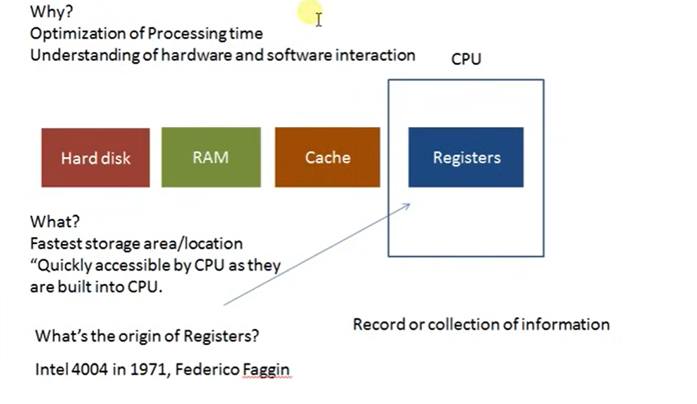

Slide 18
Memory & Registers Core Role in AL
General Purpose Register [Accumulator (I/O), Data (carry data), Base (address), Counter ]
Segment [ Code, Stack (LIFO ), data, Extra ]
Index Register [Source & Destination ]
Special Purpose [Instruction Pointer Stack Pointer Flag and Base pointer]

Slide 19
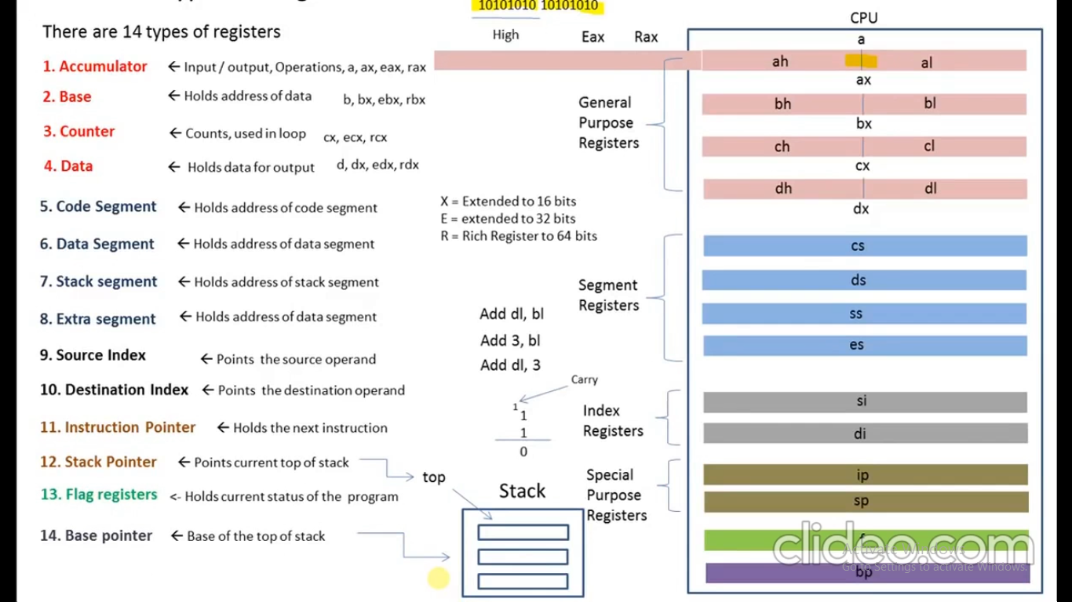

Slide 20
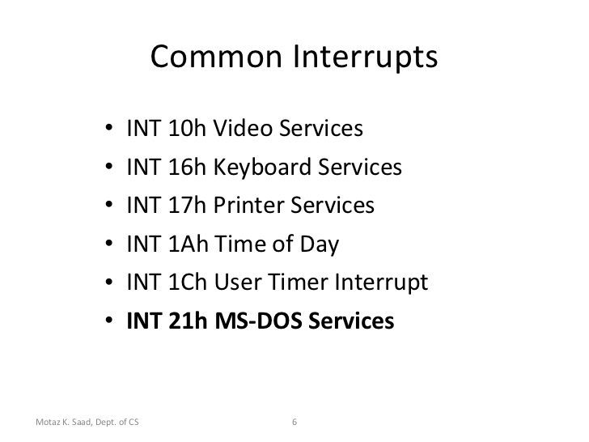
Interrupts
DOS assembly, most things get done with the DOS services interrupt int 21h, and the BIOS service interrupts like int 10h and int 16h

Slide 21
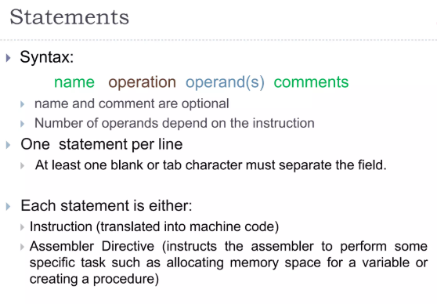
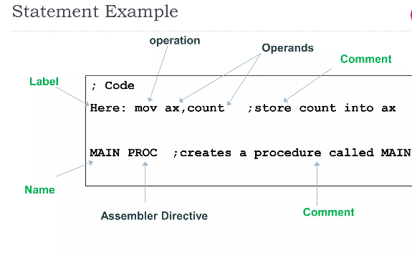

Slide 22
Segments of AL
.Memory
.Code
.Stack
.data

Slide 23
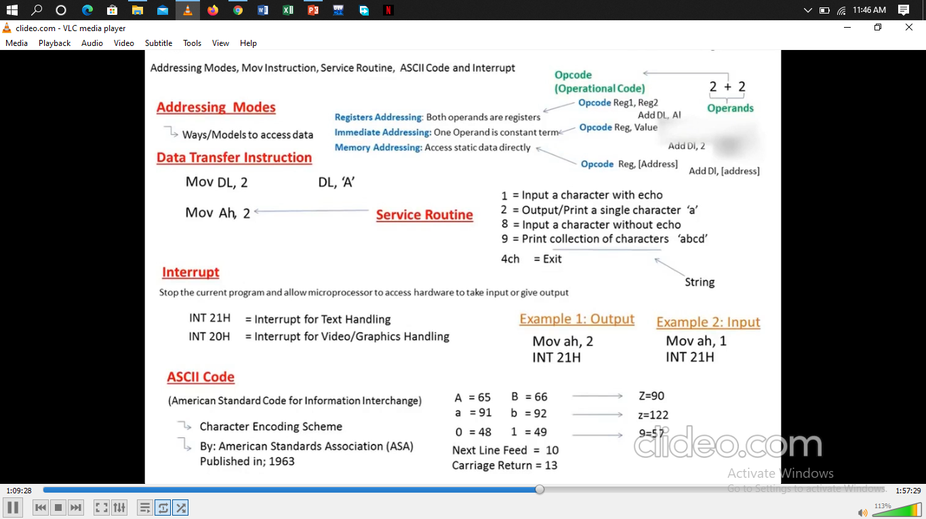

Slide 24
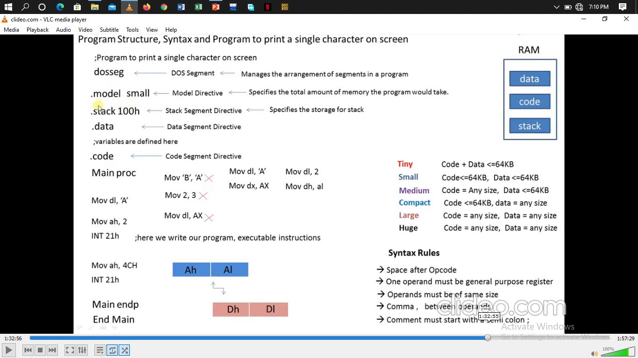

Slide 25
Basic Syntax of Assembly Language
Dosseg (DOS Segment)
.model small
.stack 100h
.data
.code
Main proc
Mov dl, ‘A’
Mov ah, 2
INT 21h
Mov ah, 4ch
INT 21h
Mov ah, 4ch
Main endp
End main

Slide 26
Link for Dosbox Programs
https://www.youtube.com/watch?v=P5JOlz7MeYg&list=PLsu3nQRCX0RIjLN0eUNzQbDFyfz8E_DJi&index=2

Slide 27
Flow Control Instructions

Slide 28
Transfer of Control
Flow control instructions are used to control the flow of a program.
Flow control instructions can be of two types: unconditional and conditional.
The JMP instruction is the only unconditional flow control instruction.

Slide 29
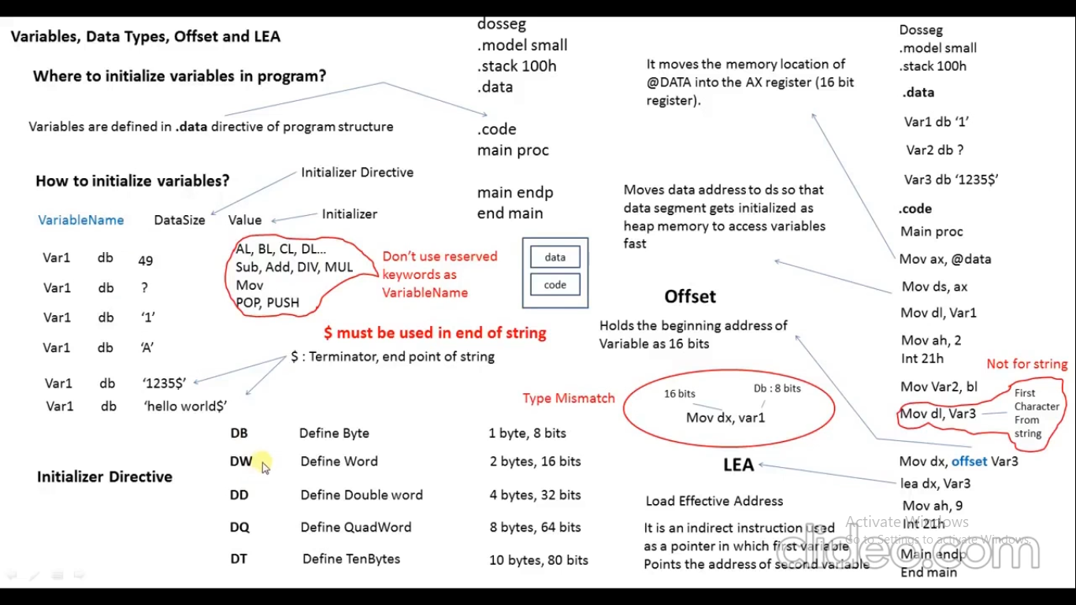

Slide 30
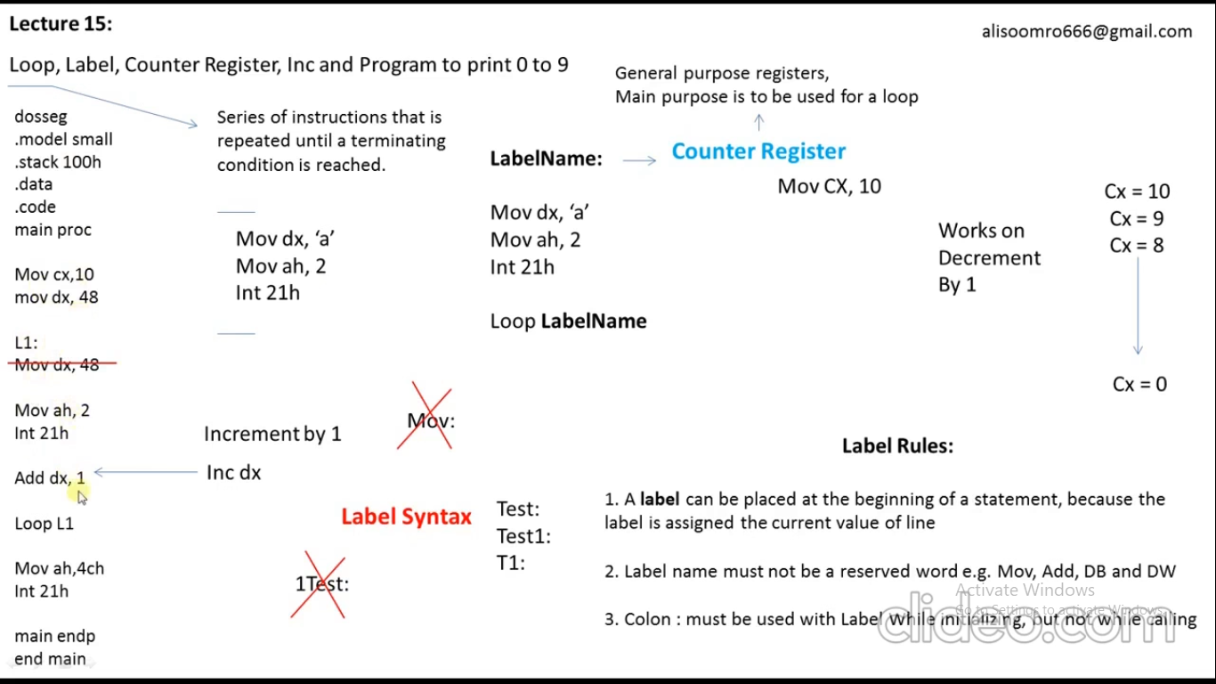

Slide 31
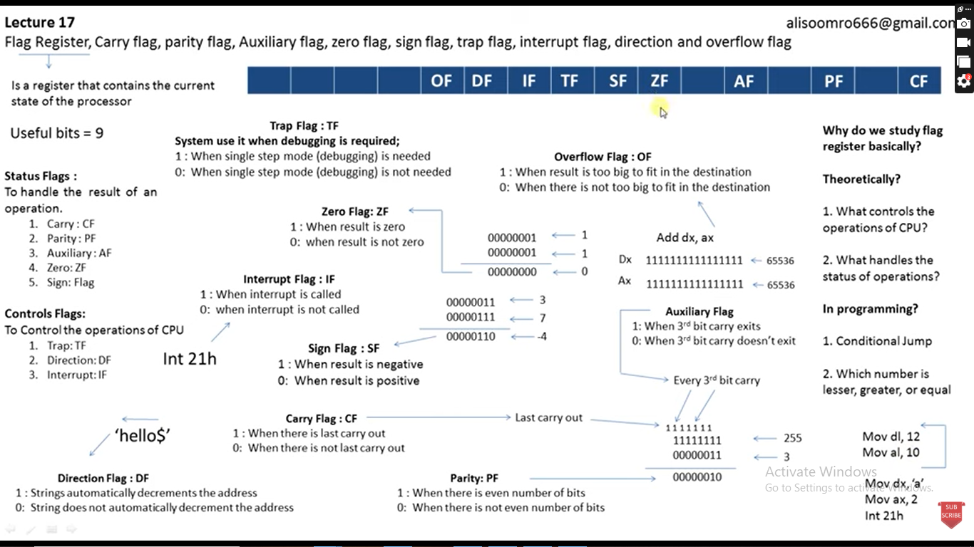

Slide 32
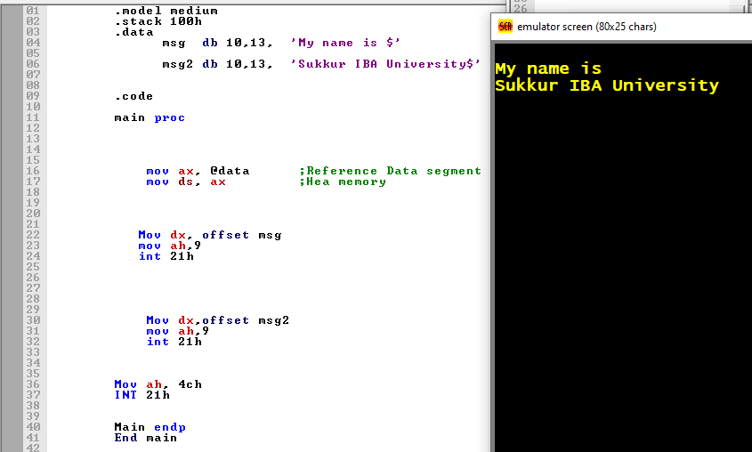

Slide 33
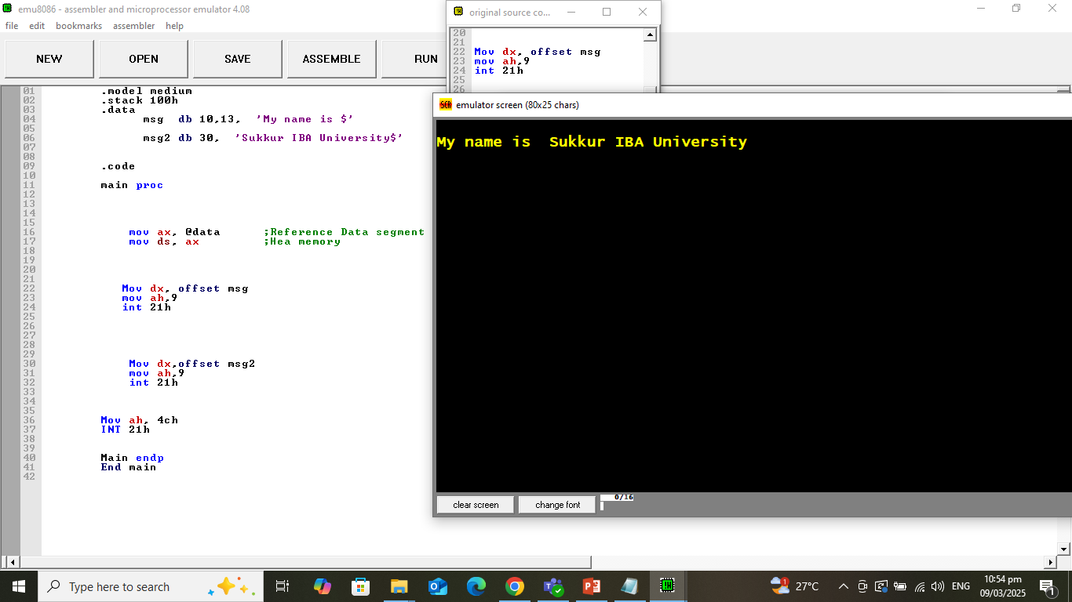

Slide 34
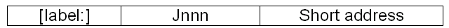
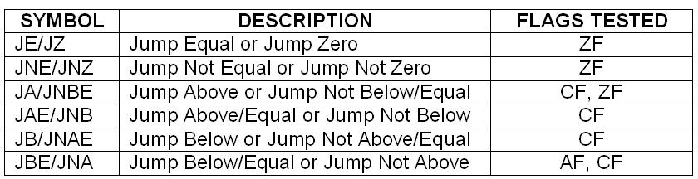
Conditional JUMP Instructions
Format for conditional jump (Jnnn) is:
There are varieties of conditional jump instructions that transfer control depending on settings in the flags register: ZF, CF, OF, AF and SF.
Table below shows some example of conditional jump that are used for unsigned data.

Slide 35
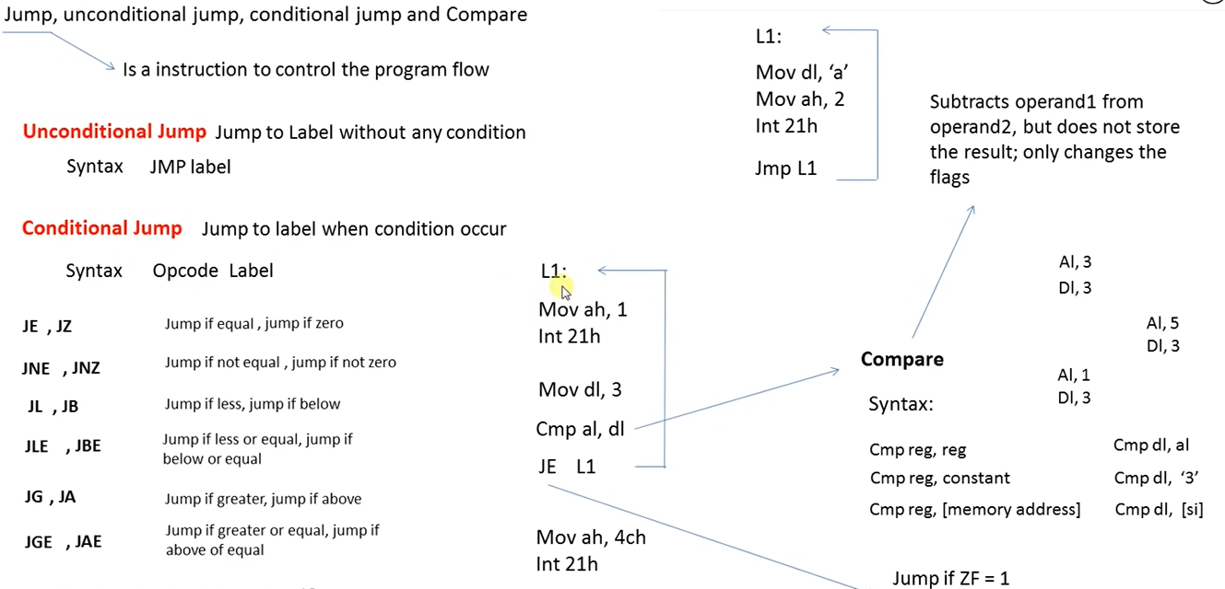

Slide 36
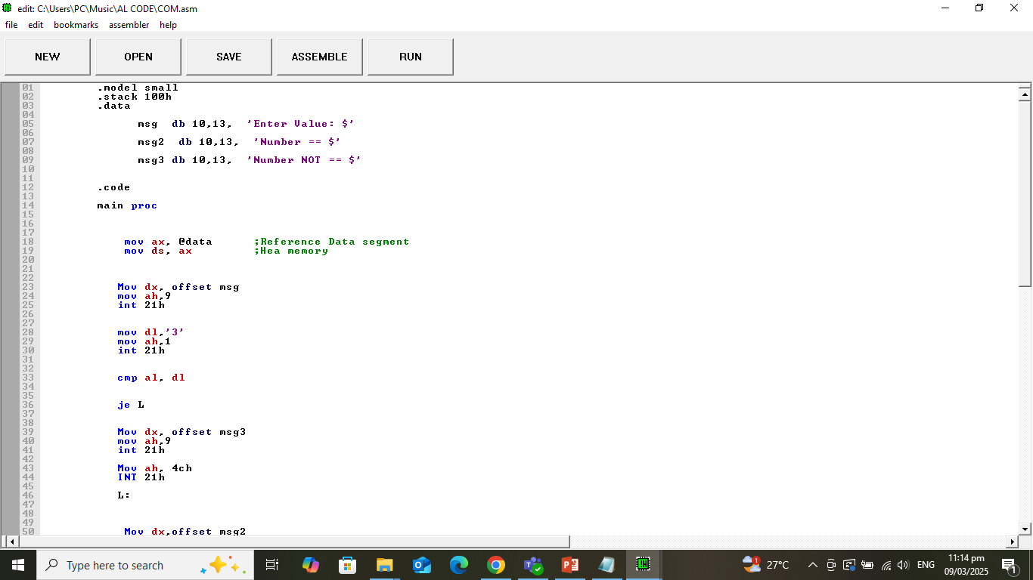
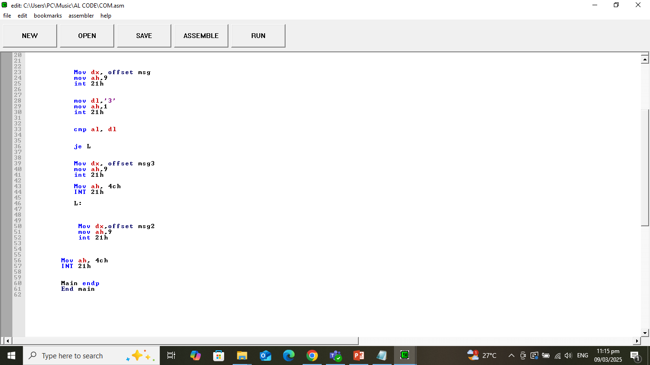

Slide 37
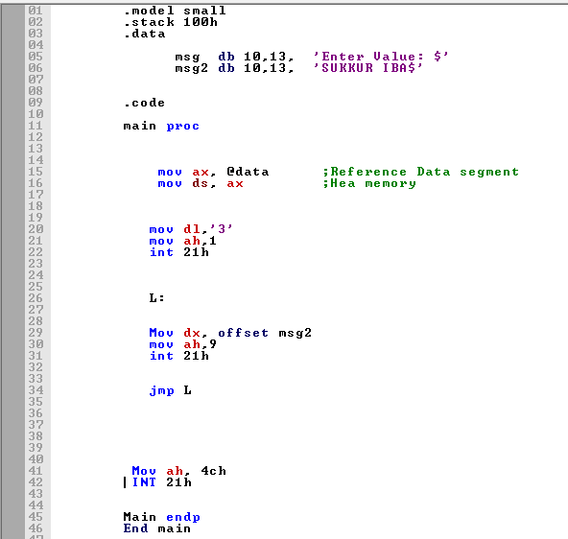

Slide 38
Example
Display the entire IBM character set
TITLE PGM6_1.ASM
.MODEL SMALL
.STACK 100H
.CODE
MAIN PROC
MOV AH,2 ; display char function.
MOV CX,256 ; no. of chars to display.
MOV DL,0 ;DL has the ASCII code of NULL char.
PRINT_LOOP:
INT 21h ;DISPLAY A CHAR.
INC DL ; INCREMENT ASCII CODE.
DEC CX ; DECREMENT COUNTER.
JNZ PRINT_LOOP ; KEEP GOING IF CX#0
; DOS exit
MOV AH,4CH
INT 21h
MAIN ENDP
END MAIN

Slide 39
Conditional jump instructions
If the flag settings match the instruction, control transfers to the target location
If the match fails, the CPU ignores the conditional jump and execution continues with the next instruction.

Slide 40
Conditional jump
In assembly language, when two numbers are compared, it is imperative to know that:
A signed number can be Greater, Less, or Equal to another signed number.
An unsigned number can be Above, Below, or Equal to another unsigned number.

Slide 41
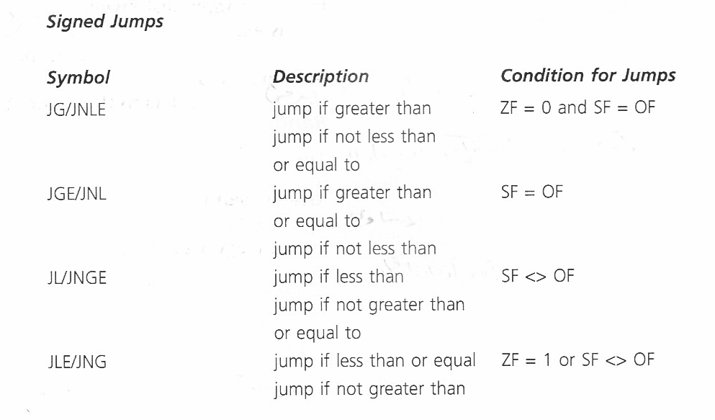
Conditional jump instructions

Slide 42
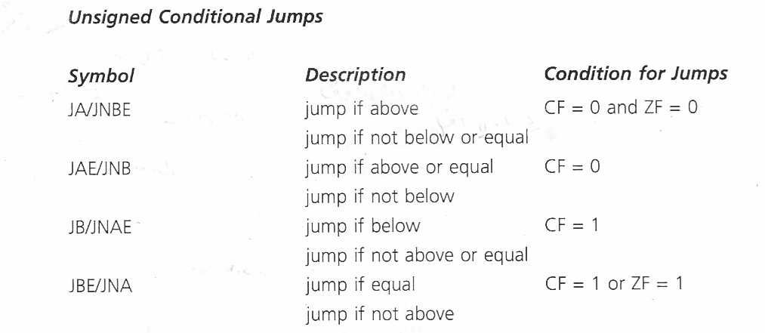
Conditional jump instructions

Slide 43
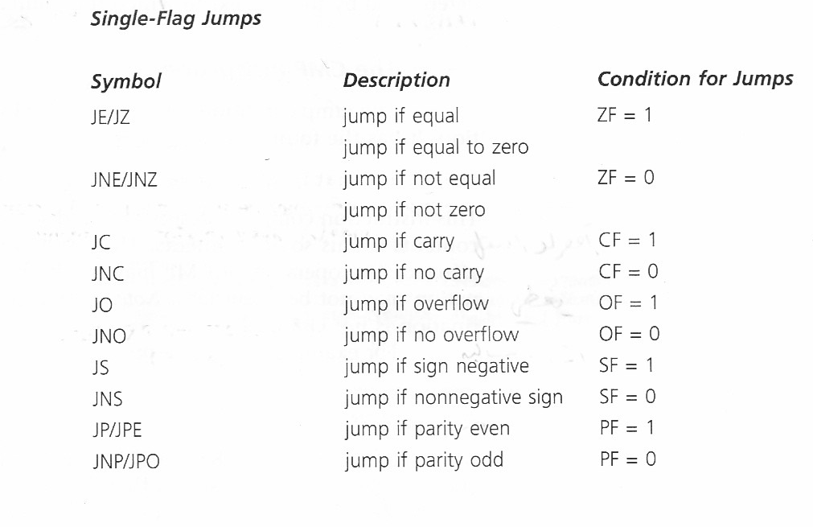
Conditional jump instructions

Slide 44
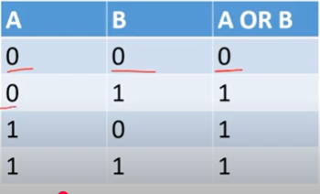
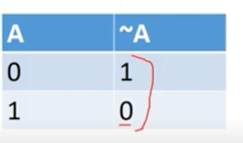
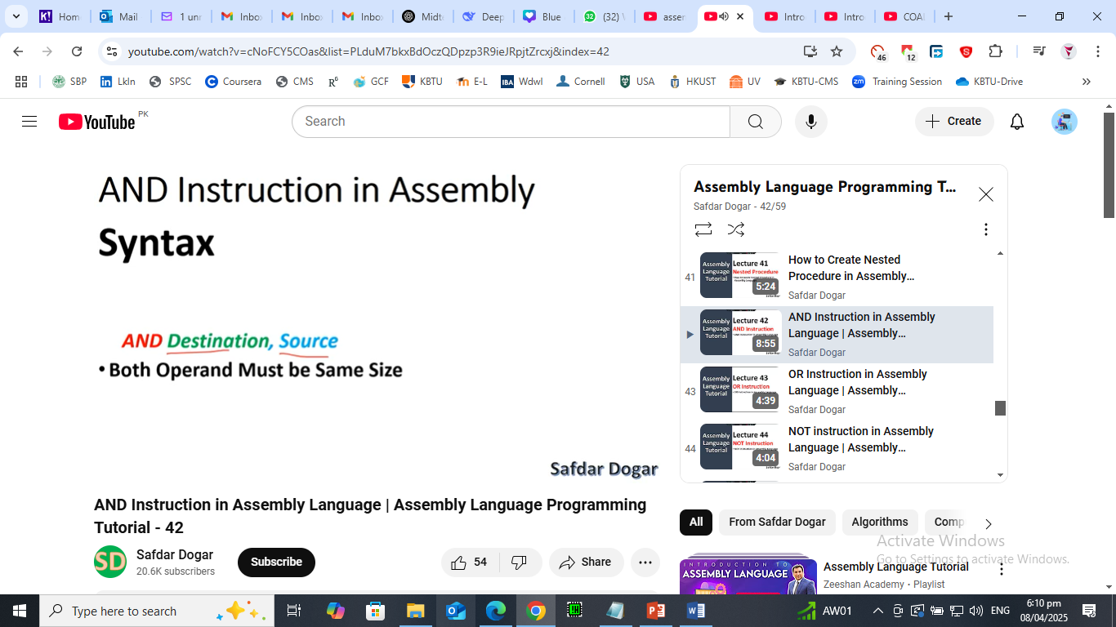
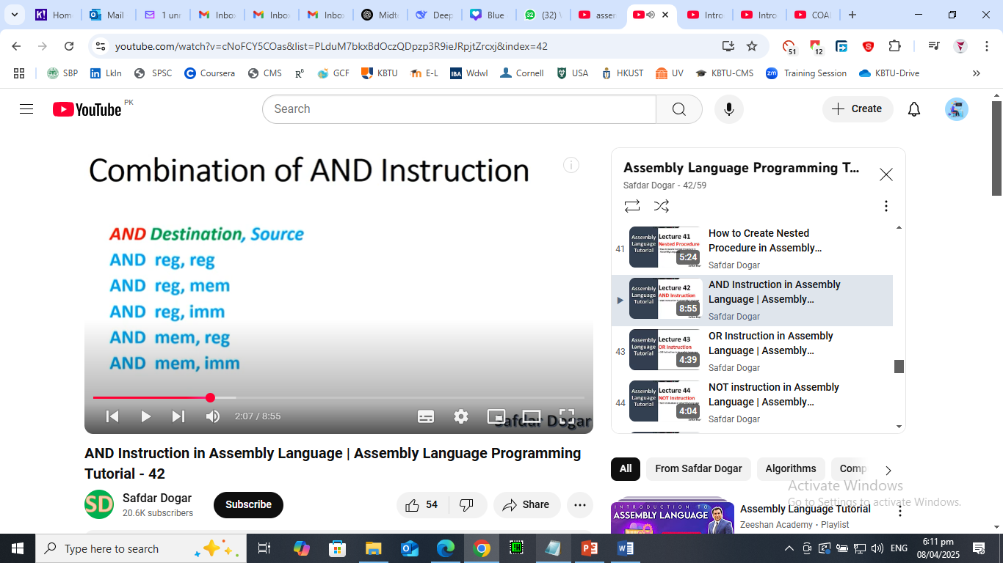
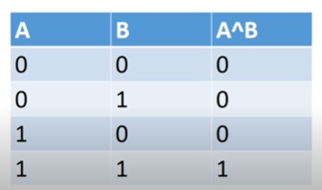
AND, OR, NOT instructions

Slide 45
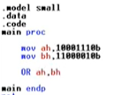
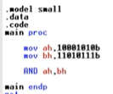


Slide 46
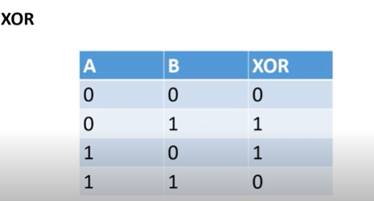
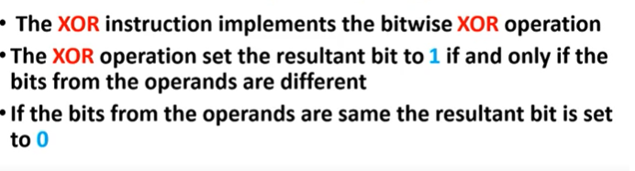
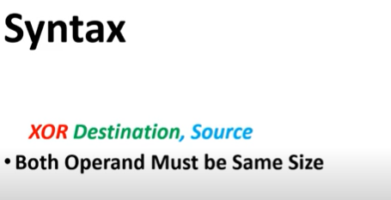
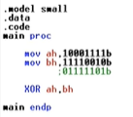
XOR

Slide 47
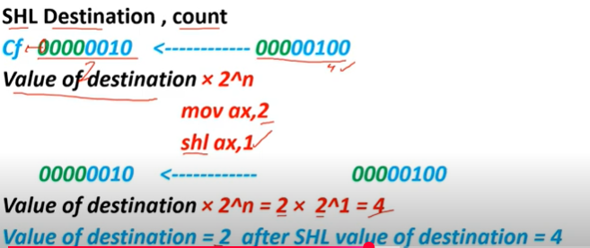

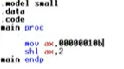

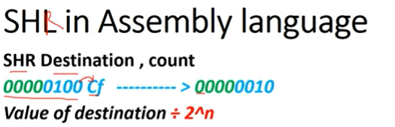
Shift and Rotate Instructions

Slide 48
Rotate, TEST instruction
Definition:
Rotate instructions move bits around in a circular way.
The bits that fall off from one end are wrapped around to the opposite end.
➤ Types:
ROL – Rotate Left
ROR – Rotate Right
RCL – Rotate through Carry Left
RCR – Rotate through Carry Right
✅ Example – ROL AL, 1
If AL = 1001 0110 → After rotate left → 0010 1101
Key Point: No bits are lost. Bits are recycled.

Slide 49
Con..
Shift Instructions (SHL, SHR, SAL, SAR)
🔹 Definition:
Shift instructions move bits left or right, but the bits that fall off are lost,
and zero or the sign bit is shifted in.
➤ Types:
SHL or SAL – Shift Left (inserts 0 at right)
SHR – Shift Right (inserts 0 at left)
SAR – Arithmetic Shift Right (preserves sign bit for signed numbers)
✅ Example – SHL AL, 1
If AL = 1001 0110 → After shift left → 0010 1100
Key Point: Bits are lost, and zeros (or sign) are shifted in.
Used for multiplication or division by powers of 2.

Slide 50
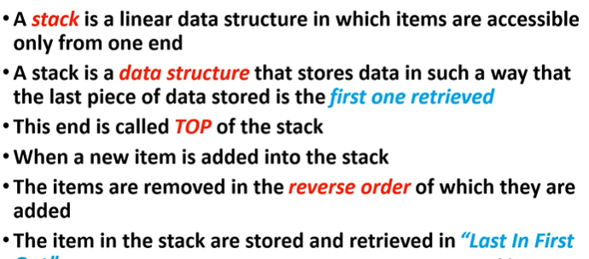

Slide 51
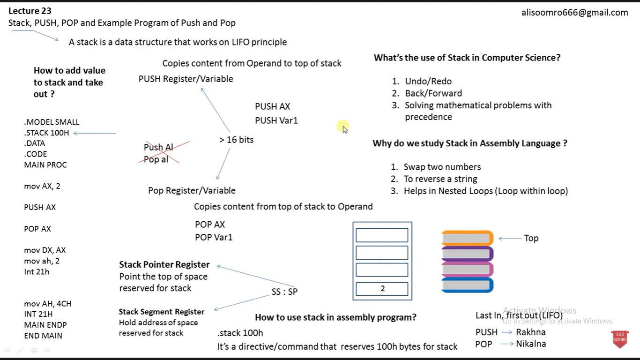

Slide 52
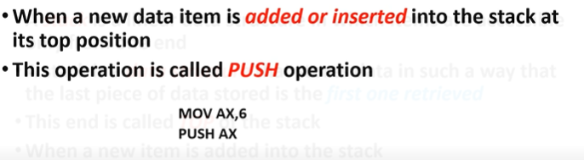


Slide 53


Slide 54


Slide 55


Slide 56




Slide 57


Slide 58


Slide 59



Slide 60



Slide 61


Slide 62



Slide 63




Slide 64


